Slide 1

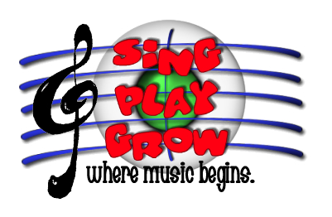
The ABCs of MLT:
A Music Therapist’s Introduction to
Music Learning Theory
Kellee Coviak Hansen, MT-BC
CODA Music Therapy Services, LLC (Lansing, MI)
kellee@codamts.com
Handouts available at: http://wp.me/P2c22o-5O

Slide 2
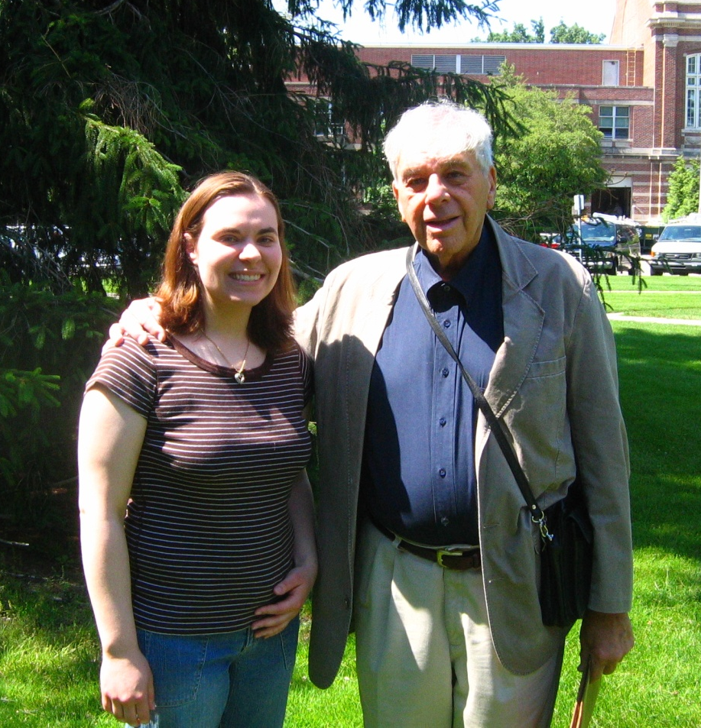

My Background with MLT
Michigan State University
  Double major: Music Therapy & Music Education
  Dr. Cynthia Taggart
  Began teaching Early Childhood Music classes at CMS
Certification by Gordon Institute for Music Learning
  Early Childhood Level 1 (2008)

Slide 3
What is Music Learning Theory (MLT)?
“Music Learning Theory is an explanation of how we learn when we learn music. Based on an extensive body of research and practical field testing by Edwin E. Gordon and others, Music Learning Theory is a comprehensive method for teaching audiation, Gordon’s term for the ability to think music in the mind with understanding. Music Learning Theory principles guide music teachers of all stripes–early childhood, elementary general, instrumental, vocal, the private studio–in establishing sequential curricular goals in accord with their own teaching styles and beliefs. The primary objective is development of students’ tonal and rhythm audiation. Through audiation students are able to draw greater meaning from the music they listen to, perform, improvise, and compose.” (GIML website)
Notes:
Gordon does not have a “method” → emphasizes sequential learning and adapting to individual needs.

Slide 4
Why Music Learning within Music Therapy?
Collaboration & consultation with music educators
Chronological age vs. developmental age
Research-based
Secondary benefit → well-rounded, quality music experience

Slide 5
Important MLT Concepts
Children learn music like they learn language
Exposure to a wide variety of tonalities and meters
Music aptitude ≠ music achievement
Audiation
Importance of movement for musical development

Slide 6
Children learn music like they learn language:
Language learning
Infants absorb what they hear
Vocalize sounds in imitation (babble)
Develop ability to articulate sounds of native languge
Adults model/provide informal guidance for forming words
Successful imitation of words
Children improvise their own phrases & sentences
Learn to read & write words and sentences that they have heard and spoken
Formal training in grammatical structure

Slide 7
Language learning
Sequential development of four language vocabularies:
  Listening
  Speaking
  Reading
  Writing
Language learning begins prenatally and continues into school years

Slide 8
Types of Preparatory Audiation
Acculturation
  Birth to age 2-4
  Participates with little consciousness of the environment
Imitation
  Ages 2-4 to 3-5
  Participates with conscious thought focused primarily on the environment
Assimilation
  Ages 3-5 to 4-6
  Participates with conscious thought focused primarily on the self

Slide 9
Stages of Preparatory Audiation: Acculturation
Absorption
  Hears and aurally collects the sounds of music in the environment
Random response
  Moves and babbles in response to, but without relation to, the sounds of music in the environment
Purposeful response
  Tries to relate movement and babble to the sounds of music in the environment

Slide 10
Stages of Preparatory Audiation: Imitation
Shedding Egocentricity
  Recognizes that movement and babble do not match the sounds of music in the environment
Breaking the Code
  Imitates with some precision the sounds of music in the environment, specifically tonal patterns and rhythm patterns

Slide 11
Stages of Preparatory Audiation: Assimilation
Introspection
  Recognizes the lack of coordination between singing, chanting, breathing and movement
Coordination
  Coordinates singing and chanting with breathing and movement

Slide 12
Skill Learning Sequence: Discrimination Learning
Aural/Oral
  Listening and singing
  Neutral syllables
Verbal Association
  Associate vocabulary/proper names with the patterns, functions, tonalities, and meters learned at aural/oral level
  Tonal and rhythm syllables introduced
Partial Synthesis
  Learn to give syntax to series of tonal or rhythm patterns.
Symbolic Association
  Learn to read and write music notation for previously learned patterns.
Composite Synthesis
  Read and write a series of tonal and rhythm patterns with the ability to identify the tonality or meter of the series.
Notes:
Each level builds on previous levels
Remember language learning sequence:
Listening
Speaking
Reading
Writing

Slide 13
Skill Learning Sequence: Inference Learning
Generalization
  Three sublevels: aural/oral, verbal, and symbolic.
  Able to audiate unfamiliar patterns by comparing them to familiar patterns learned by rote. (e.g. “same/different”)
Creativity/Improvisation
  Creativity has fewer restrictions that improvisation.
Theoretical Understanding
  Music theory applied to music knowledge
  “Whereas in discrimination learning a teacher teaches a student both what to learn and how to learn it, in inference learning a teacher teaches a student only how to learn. The student teaches himself what he learns.” (GIML website)

Slide 14
Exposure to a wide variety of tonalities and meters
Emphasize tonic-dominant relationship
Songs → tonality, chants → meter
Songs and chants without words
  “Text diverts the child’s attention from the music itself” (Gordon, pg. 51)
Repetition, repetition, repetition!

Slide 15
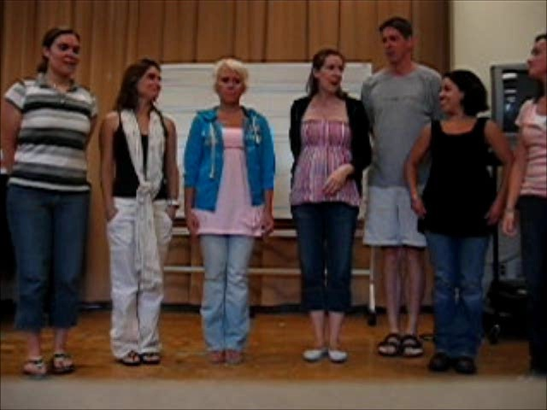
Tonalities
Handout
Major (1)
Dorian (2)
Phrygian (3)
Lydian (4)
Mixolydian (5)
Aeolian (6)
Harmonic Minor (6)
Melodic Minor (6)
Locrian (7)
Multitonal
MLT Workshop: “Drunken Sailor”
Notes:
Drunken Sailor in Mixolydian

Slide 16
Meter
Handout
Duple
Triple
Unusual Paired
Unusual Unpaired
Mixed Meter
Notes:
Rationale behind Gordon syllables:
Macrobeat is always the same syllable (Du)
Syllables at the front of the mouth are easiest for children

Slide 17
Music aptitude ≠ music achievement
Aptitude: measure of children’s potential to learn music
Achievement: evidence by what children have learned relative to their aptitude
Tonal aptitude and rhythm aptitude separate
Purpose of measuring music aptitude is to help music teachers meet unique needs of students, not to idenitify students for inclusion/exclusion in music activities.
Developmental music aptitude until ~ age 9, stabilized music aptitude after age 9.
Notes:
Students who have a high level of achievement music also have a high level of music aptitude, but there are students who have low music achievement and high music aptitude. Aptitude tests help teachers identify students whose needs are not being met.

Slide 18
Music Aptitude Tests (Developmental)
  Audie
    Game for 3-4 year olds
    Discriminate “special song” from music examples
  Primary Measures of Music Audiation (PMMA)
    K-Grade 3, including those with special needs
    Administered within groups or individually
    Consists of Tonal and Rhythm subtests
  Intermediate Measures of Music Audiation (IMMA)
    More advanced version of PMMA, only difference is difficulty of questions
    Ages 6-9 and 10-11 (stabilized)

Slide 19
Music Aptitude Tests (Stabilized)
  Musical Aptitude Profile (MAP)
    Designed to measure 7 dimensions of stabilized music aptitude
    Grades 4-12, administered individually or in groups
    Since it is a measure of stabilized aptitude, needs to be given only once throughout school career
    No formal music training required in order to receive a high score.
  Advanced Measures of Music Audiation (AMMA)
    High school students and college music & non-music majors

Slide 20
Music Aptitude Tests
  Harmonic Improvisation Readiness Record (HIRR)
    Designed for all ages
    Purpose is to help objectively determine whether students have harmonic readiness to learn improvisation & adapt improvisation instruction
  Rhythm Improvisation Readiness Record (RIRR)
    Designed for all ages
    Purpose is to help objectively determine whether students have ability to handle temporal relations
  Instrument Timbre Preference Test (ITPT)
    Grades 3-12
    Purpose is to help students choose an instrument for beginning instrumental instruction.
  Iowa Tests of Music Literacy (ITML)
    Multi-level test designed to measure dimensions of music achievement
    Six subtests, classified into two divisions (Tonal Concepts & Rhythm Concepts)

Slide 21
Audiation
Ability to comprehend/think music, “hear silently”
Proof that audiation is occuring: demonstrate the ability to play/sing in another key.
  Example of student and Goodbye Song.
  Audiate resting tone → “Need” resolution of unfinished phrase

Slide 22
Importance of movement
Provides readiness for understanding musical style
Allows for expression in music performance
  MT: Social-emotional, communication domains
Provides readiness for rhythm learning through development of beat competency and physical coordination
  MT: Fine and gross motor development
Develops rhythmic music aptitude

Slide 23
Movement
Body awareness
MLT uses movement element continuums developed by Rudolf Laban (dance theorist)
  Flow: Free ↔ Bound
  Weight: Strong ↔ Gentle
  Space: Indirect ↔ Direct
  Time: Fast ↔ Slow
Locomotor & non-locomotor movement
Simple circle dances

Slide 24
Examples from Practice
Secondary SCI student, nonverbal – singing interval
Instrument Mounts video
  “Dancing” [#7 Songs & Chants; Dorian, Duple]

Slide 25
Sources for additional information
GIML website: http://giml.org/
GIA Publications: http://www.giamusic.com/bios/edwin-gordon
  Titles include:
    Music Play
    Songs and Chants Without Words; More Songs and Chants Without Words
    Jump Right In Series
    Aptitude tests
Research articles

Slide 26
Resources
Bolton, B. M., Taggart, C. C., Reynolds, A. M., Valerio, W. H., & Gordon, E. E. (2001). Jump right in: The music curriculum. Chicago, IL: GIA Publications.
Gordon Institute for Music Learning. Available at http://giml.org.
Gordon, E. E. (2003). A music learning theory for newborn and young children. Chicago, IL: GIA Publications.
Gordon, E. E., Bolton, B. M., Hicks, W. K., & Taggart, C. C. (1993). Experimental songs and chants. Chicago, IL: GIA Publications.
Valerio, W. H., Reynolds, A. M., Bolton, B. M., Taggart, C. C., & Gordon, E. E. (1998). Music play: The early childhood music curriculum guide for parents, teachers, and caregivers. Chicago, IL: GIA Publications, Inc.

